Slide 1

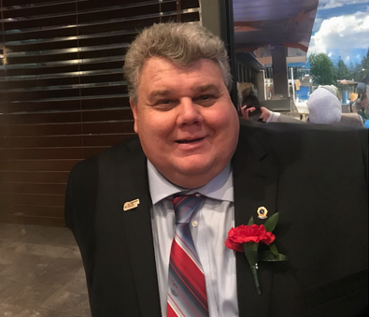


JUNE 2023
Gloucester City Newsletter
In the News
by Derek Timm, Council
The dog days of summer are here and don't forget that the GCBBA (Gloucester City Brooklawn Business Association) and the Gloucester City Summer Concert Series event organizer have teamed up. This news along with the NJ Irish Society sponsoring a beer garden at each concert is sure to provide an enhanced and more pleasurable free concert experience.
From 7 am - 5 pm Monday - Friday over the next several months, Nicholson Road westbound is scheduled to only have one lane with a flagger to direct traffic. Be prepared to stop and for delays traveling this direction. The $1.9 million federally funded project will relocate utilities near the I-76 Bridge over Nicholson Road.
An ordinance was enacted and passed no longer allowing large trucks to drive along Johnson Blvd. This action was taken by the Mayor and Council to enhance the safety of all residents while preserving the infrastructure and maintaining quality life of standards in a residential neighborhood.
Mayor's Message
From Mayor Baile
Gloucester City Mayor and Council are happy to be celebrating the 400th Anniversary of the first European contact with the Lenni Lenape and the first European settlement on the Delaware River in 2023 and a few events are planned throughout the year.
If you are a senior and need transportation, did you know that a limited complimentary shuttle service is available? Senhan Transit Route Information Gloucester City times and schedule is available on our city website.
Gloucester City has teamed up with the State of NJ to have eligible residents be able to apply for the Low Income Household Water Assistance Program to provide help for those struggling with their utility bills. This program is provided by the NJ Dept. of Community Affairs and contact the State directly at waterassistance.nj.gov or call 211 for additional information.
I would like to thank
everyone who came out and
participated in our Memorial
Day services. We all need to be
thankful for all that our Veterans
have sacrificed for our freedom.
A big thank you to Bruce Parry for organizing the program; it was enjoyed by all.
As Gloucester City Celebrates 400 years as a settlement we hope everyone will come out to Proprietor's Park on June 24th for our Fireworks celebration and enjoy the music and food. We look forward to many more events at Proprietors Park in the fall, and we hope everyone enjoys the summer concert series at the Park as well.
We would like all residents to please help us to keep Gloucester City clean by picking up after their dogs. This is required by city ordinance. And please don't put your trash out before 6 pm the night before pickup.
Mayor and Council continue to work with developers and businesses who are looking to come to Gloucester City and we hope to have some news to share shortly. Have A Great Summer And Be Safe
Mayor Dayl Baile
Mayor Dayl Baile
Congrats to all the graduates!

Slide 2
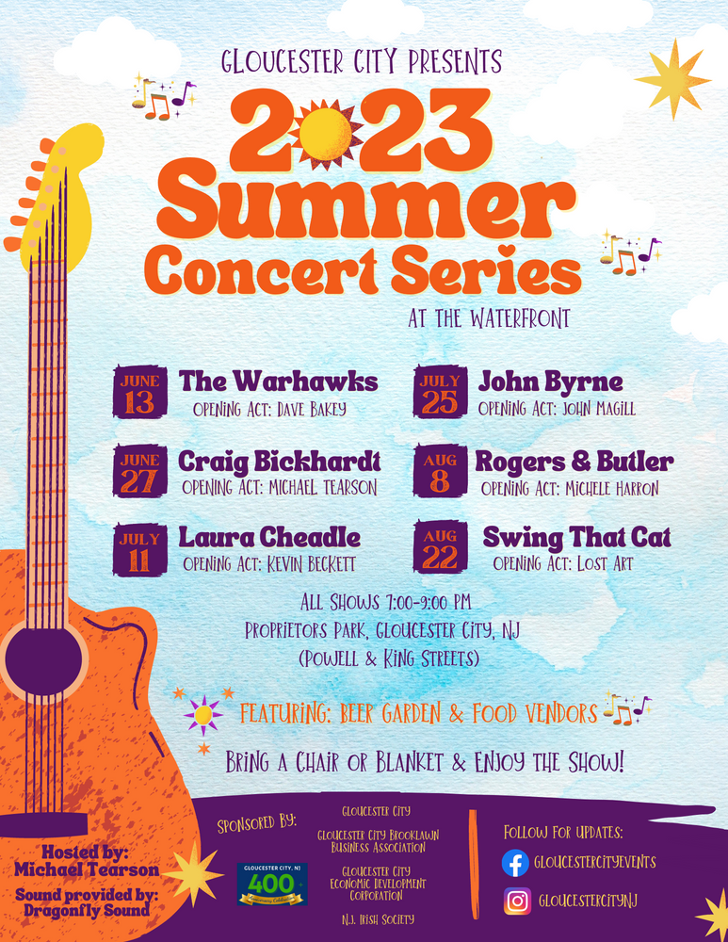


JUNE 2023
Gloucester City Newsletter
Gloucester Town Corner
by Patrick Ward
UPCOMING EVENTS:
*Editor's note: In 1952, the Saddlemen lineup consisted of Johnny Grande, Marshall Lytle and pedal-steel guitarist Billy Williamson. According to the band members they became The Comets in the fall of 1952. It appears there is evidence of them still performing as the Saddlemen until December of 1952.
To see the actual artifacts about this article,
https://www.gloucestercityhistoricalsociety.org/bill-haley-rock-n-roll
Gloucester City Historical Society
34 N. King Street - Gloucester City, NJ 08030
https://www.gloucestercityhistoricalsociety.org/
Gloucester City - New Jersey is commemorating the 400th Anniversary of the first European contact with the Lenni Lenape and the first European settlement on the Delaware River this year.
Gloucester City the birthplace of Rock & Roll? It’s true! Bill Haley is considered to be one of the first true rock stars and as such, Gloucester City can be considered one of the birthplaces of Rock 'n Roll. In 1951, Bill Haley and his band, then known as the Saddlemen started playing in Gloucester City at the Twin Bar on the corner of Market Street and Broadway. As early as March 1951 to late December 1952, "Billy Haley and his Saddlemen" would give birth to their version of Rockabilly.
"This [ Twin Bar] is where we did 5 - 45 min. shows a night, 6 nights a week, plus a one-hour LIVE Radio Show every day. Billy, Johnny, and I, all made $60.00 per week except Bill got leaders pay of $90.00." - MARSHALL LYTLE of the Comets.
On New Year's Eve; December 31, 1952 the newly named "Bill Haley with Haleys Comets' ' would appear on an advertisement bill for the first time at the Berky's Seafood House in Chester PA. Haley would go on to be one of the first stars of Rock n Roll. In 1987 Haley would be inducted into the Rock n Roll Hall of Fame in the 2nd year of the HOF. The Comets were inducted in 2012 in the HOF as a group. In a 1953 advertisement, Bill Haley acknowledges the Twin Bar in the announcement of the band's new name.
Mayor Dayl Baile
For tax and utility
payment due reminders
www.cityofgloucester.org/subscribe

Slide 3
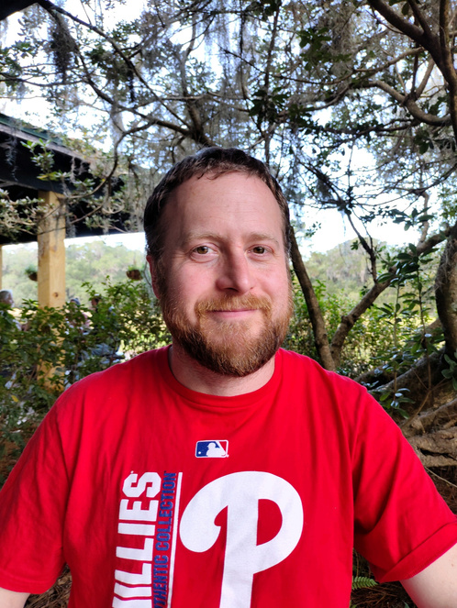


JUNE 2023
Gloucester City Newsletter
Employee Highlight
by Administrator Chief Brian Morrell
Raymond Bennett
Supervising Water Treatment Plant Operator
I have lived in Gloucester my entire life. I started with the Water Department in 2019 at the age of 20, but enjoyed working many Summer seasons with the Highway Department before I was employed full-time.
My main position is to ensure proper water treatment for the city, as well as ensure quality standards are upheld. I also manage water and sewer repairs throughout the town with the help of our amazing employees. At just the beginning of this year I took over the supervisor role for the department and I am working every day to better myself in the role.
I hope to expand the connection between the Water/Sewer Department and the public to make sure citizens are happy with our services and know they can reach out with any problems or concerns and expect a swift response from our department.
I have a degree in Mechanical Engineering, as well as T2 and W2 Water Licenses and I am working to obtain higher classifications when I am able. I am also very well-versed in technology and love tinkering with things, which helps in this line of work.
The Water/Sewer line of work can be very difficult and stressful, but it can be rewarding when we get to help the community. I hope to continue with the city for many years into the future with the city, and possibly one day obtain the licenses and qualifications to be able to become Director of the Water Department when that position is available.
GETTING TO KNOW US
Derek Timm
Council at large
  How long have you lived in Gloucester City? 16 years
  How long have you been a Councilman? 1 1/2 years
  Your favorite place in Gloucester City? My house
  Fondest memory of Gloucester City? Bringing my son home after he was born
  Favorite Ice Cream Flavor? Super Premium Handcrafted Madagascar Vanilla Bean
  Favorite hobby? Travelling the world
  Favorite musical artist or group? Guns n Roses
  Favorite Restaurant? Bianyifang - Beijing, China, Famous for its Peking Duck, and was founded more than 600 years ago
  Favorite Sport? Baseball
  Favorite Politician of all time? Any politician who stands up for the people and not the agenda of special interest groups, lobbies, or parties
www.cityofgloucester.org/subscribe

Slide 4


JUNE 2023
Gloucester City Newsletter
Library News
by Wen Gnu
The Gloucester
High School
cast will perform
in the Betsy
Ross Griscom
wedding reenactment on
November 4, 2023
at 1 pm
Betsy Ross Pavilion
Proprietors Park
All our welcome to attend the ceremony at the park. Reception reservations are filled. Thank you all for your interest in our 400th celebration!
Upcoming NPP Grant Funded Projects
Is it too hot to play outside? Don’t allow the summer heat to make your kids bored indoors. Let them stay cool and entertained! Gloucester City Library is excited to announce that library cardholders may now check out video games. Their collection consists of games for Nintendo Switch, Sony PlayStation 4, and Microsoft Xbox One.
And, did you know????????
Want to plan a road trip to go somewhere with the kids during summer break, but don’t want to spend a lot of money? Free Museum Passes at the Gloucester City Library! Choose from:
  Academy of Natural Sciences
  Battleship New Jersey
  Eastern State Penitentiary
  Mutter Museum
  Penn Museum
  Wheaton Arts and Cultural Center
  Woodford Cedar Run Wildlife Refuge
All museum passes may only be checked out to an adult card holder for no more than three days.
https://www.gloucestercitylibrary.org/
Year 2 of NPP to include
  Safety Security Initiative - Camera Installations in Irishtown
  Residential Facade grants
  Commercial Facade grants
  Complete Phase II Electrical Upgrades at Proprietors Park
  Mural on Carr's Hardware wall
Upcoming UEZ Grant Funded Projects
  New Holiday decorations for Proprietors Park, King Street and Broadway
  Holiday Christmas tree
  New City entrance signs

Slide 5

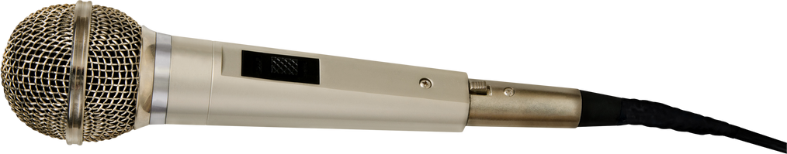
JUNE 2023
Gloucester City Newsletter
Community News
by Lori Ryan
Committee News
Last year, Gloucester City applied for and received from the NJ Board of Public Utilities a $10,000 grant to develop a Community Energy Plan (CEP).
The purpose of the CEP is to help Gloucester City plan for and invest in energy resilience, renewable energy, and efficiency to work towards a better environment for all residents.
In crafting this blueprint for our community’s energy future, we will be working to develop sustainable strategies that increase clean energy production, reduce energy use, and cut emissions.
Is the City finally able to do repairs to the rollercoaster trail?
YESSSSS we did.....
The City of Gloucester City was recently awarded $830,000 (with no match requirement!) from the New Jersey Department of Environmental Protection’s (DEP) Green Acres Program to make various improvements at Johnson Park.
The Green Acres funds are supplementing $153,000 also recently awarded to the City through the DEP’s Local Recreation Improvement Grant for improvements to the jogging trail.
Helping Gloucester City businesses:
Over $200,000 was issued to Gloucester City businesses in the past year.
Thirteen $5,000 UEZ Business Revitalization grants 20 $7500 COVID relief business grants totaling $150,000.
Green Team - Lori Ryan
The NJ Irish Society has received a generous donation from River Point to place planters at Proprietors Park along the water and King Street. The funds will provide for some planters and the soil and first planting. We are looking for someone to adopt those planters and care for them as part of our Green Team efforts.
Celebrations - Councilman Baus
Celebrations Committee is working on the Summer Concert Series beginning in June.
June 24 Foodtrucks and Fireworks will be held at Proprietors Park beginning at 5 pm.
Pack the Park Fall Festival and Car Show will be held on October 14. Craft and food vendors are welcomed.
Mayor Dayl Baile
HEAR THIS....
Hearing in the courtroom has been made a lot easier. We used Covid Relief funds to install microphones for Mayor and Council and guests to our public meetings.
Mayor and Council are now on Facebook. Follow our page for news and events
https://www.facebook.com/
gloucestercitynjmayorandcouncil

Slide 6
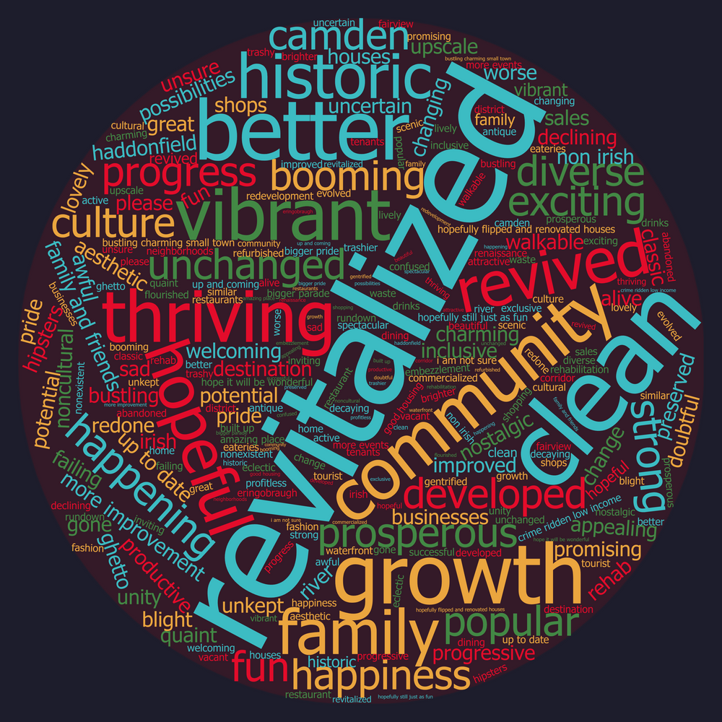

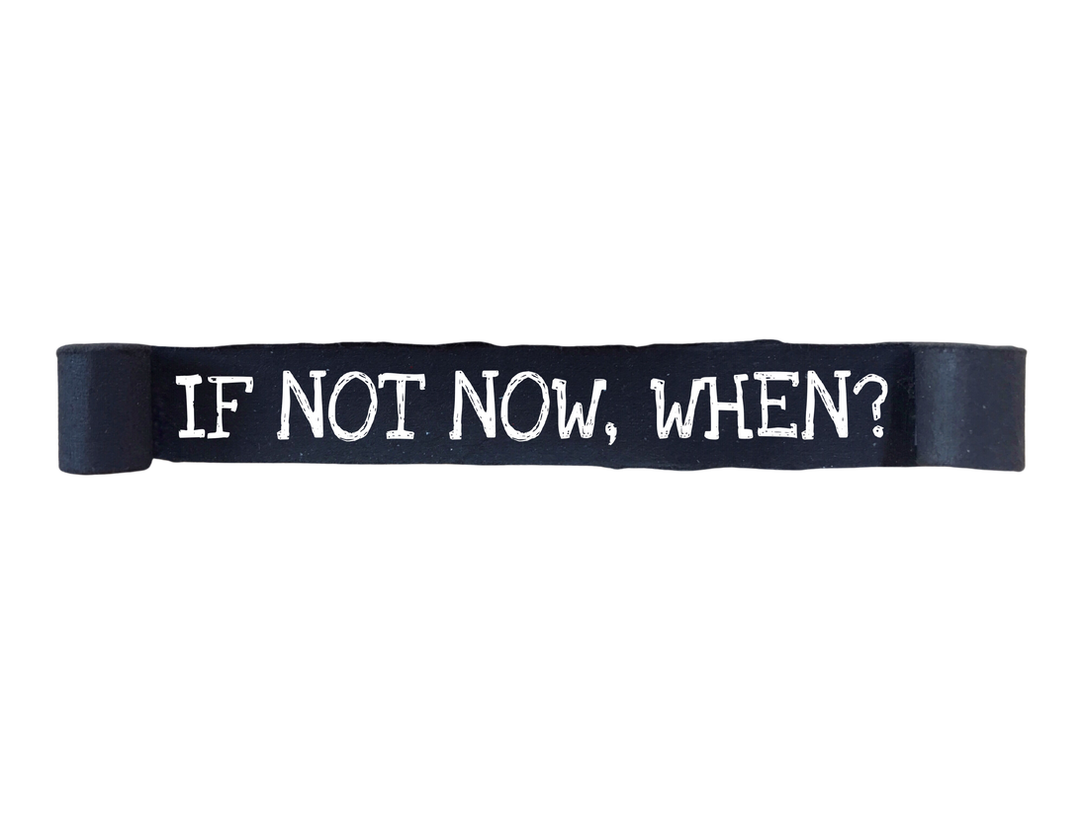


JUNE 2023
Gloucester City Newsletter
Be the first
to know...
Gloucester City is now participating in CivicReady. The Camden County Board of Commissioners of Emergency Management (OEM) is now using CivicReady to help keep Camden County residents informed during fires, outages, floods, hurricanes, evacuations, road closures and other emergency events. CivicReady will allow us to quickly alert constituents via voice, text, email and CAP/IPAWS.
This system, combined with our other emergency alert methods, is designed to get emergency messages to you, the public, quickly and effectively. This does not preclude you from calling 911 if you need emergency information; it simply provides an opportunity for us to disseminate critical information to you if and when the need arises.
We appreciate you taking the time to read this important information. Please click on the image on the left to sign up or the address below.
SIGN UP HERE FOR NOTIFICATIONS
REVITALIZED...POTENTIAL...BETTER...
Above is wordcloud from what we'd like to see happen in our neighborhoods.
Recently, there has been too much vandalism at Proprietors Park and in other neighborhoods. Please be vigilant and watch our neighborhoods and parks.
If you see something, say something.
Be part of the solution.
https://public.alertsense.com/SignUp/?regionid=1625

